Slide 1
Video Streaming
Application using RTSP/RTP
A centralized client-server model
Notes:
Motivation + nhắc chuyện là này có một vài phần mở rộng so với report

Slide 2

Our team
Nguyen Hai Dang
1952652
Luu Nguyen Hoang Minh
1952845
Nguyen Phu Nghia
1952355

Slide 3
Table of contents
01
Requirements Analysis
06
Demonstration
Our model &
the Client’s states
02
07
Technical Details:
Problems & solutions
Class diagram &
Data flow
03
08
Possible Improvements
Functionalities
04
09
Conclusion
Evaluation
05

Slide 4
01
Requirements Analysis

Slide 5
Functional requirements
RTSP for communication. RTP for data transfer: ≤ 40fps
Clients : servers = 30 : 1
Delay ≤ 0.05s
Functional scrollbar
Changeable playback speed
Adding new videos
Stream metadata
Client can shut down RTP/RTSP connections.

Slide 6
Non-functional requirements
Unused resources are released
The system works well on different OS’s
Get familiar within 1 hour of using

Slide 7
02
Our model & the Client’s states

Slide 8
Our Model
Clients
Server
initiate requests for services
provides a function or service to the clients

Slide 9
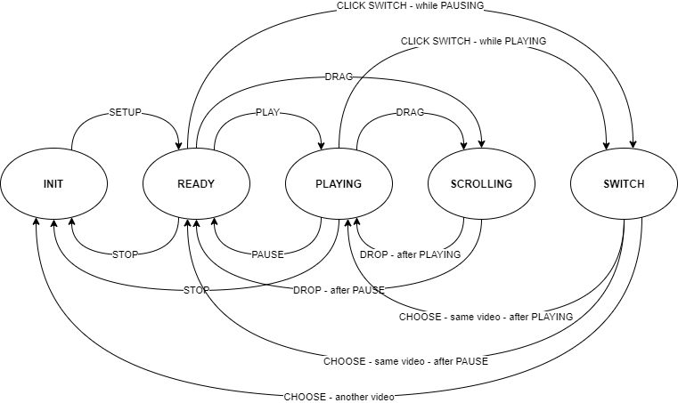
the Client’s states
INIT
READY
PLAYING
SCROLLING
SWITCHING
Notes:
State cuối là switching, không phải switch

Slide 10
Class diagram & Data flow
03

Slide 11
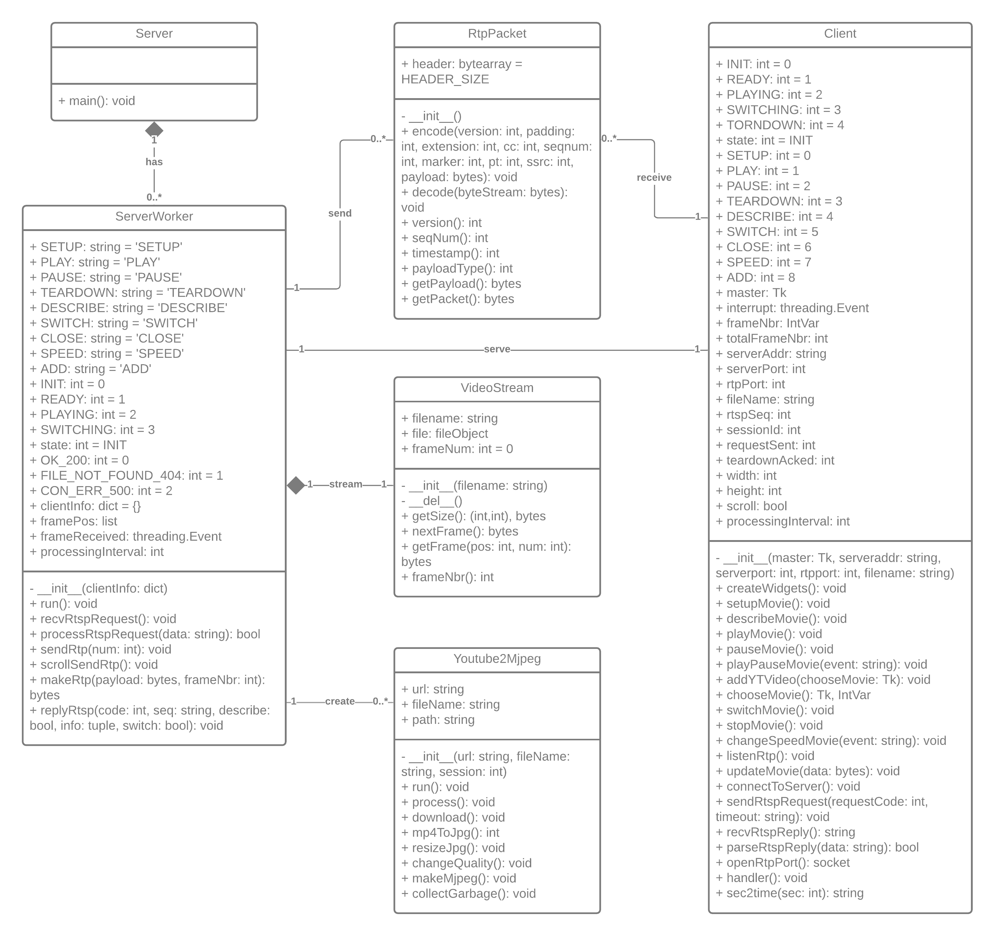

Slide 12
04
Functionalities

Slide 13
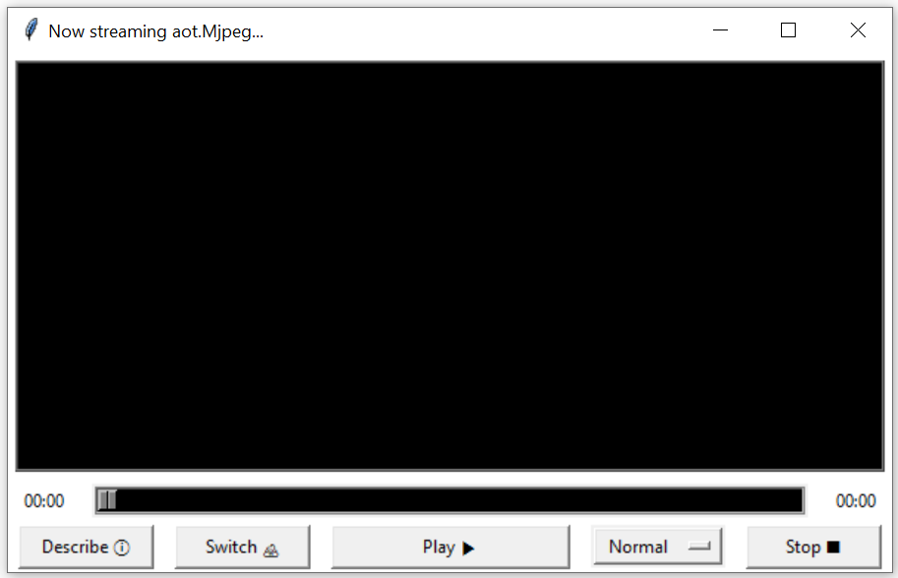
The initial state
Notes:
Này là state READY theo state diagram vì SETUP là bắt buộc cho một RTSP connection nên client sẽ tự động gọi SETUP khi vừa kết nối => state INIT giờ chỉ là temporary state

Slide 14
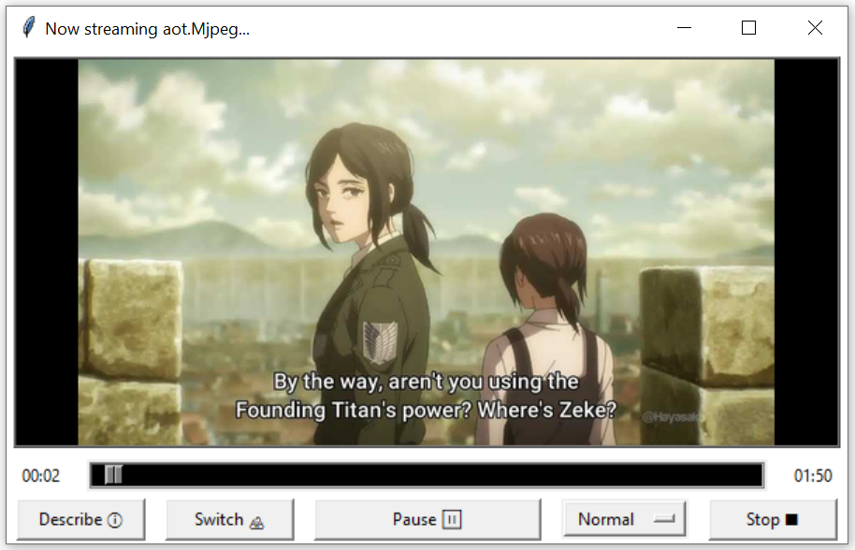
VIDEO IS PLAYING

Slide 15
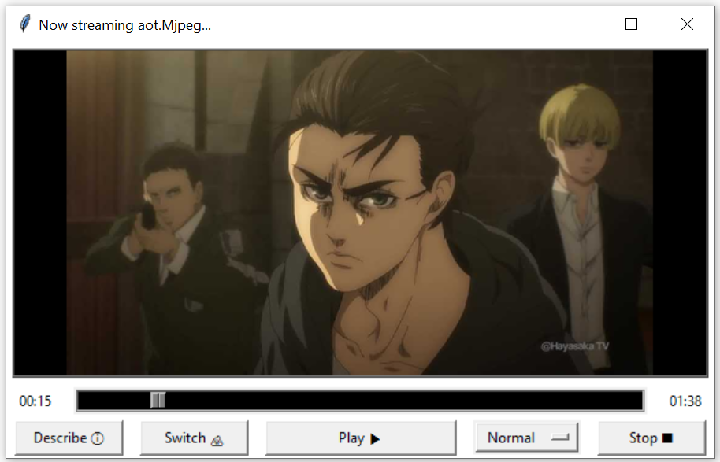
Video is paused

Slide 16
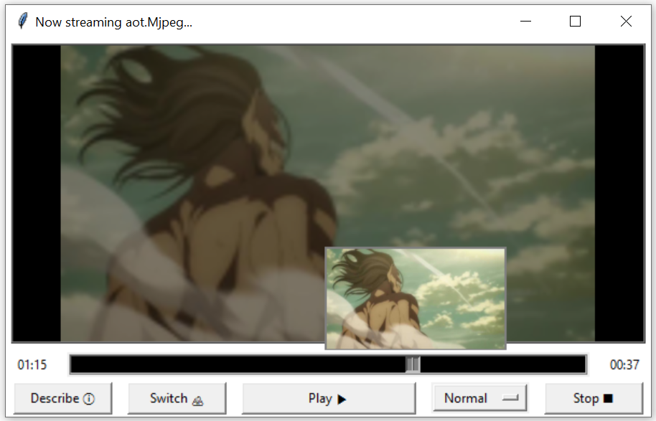
Navigating by the scrollbar forward/backward 5s
Notes:
Can also click to skip, not only scroll

Slide 17
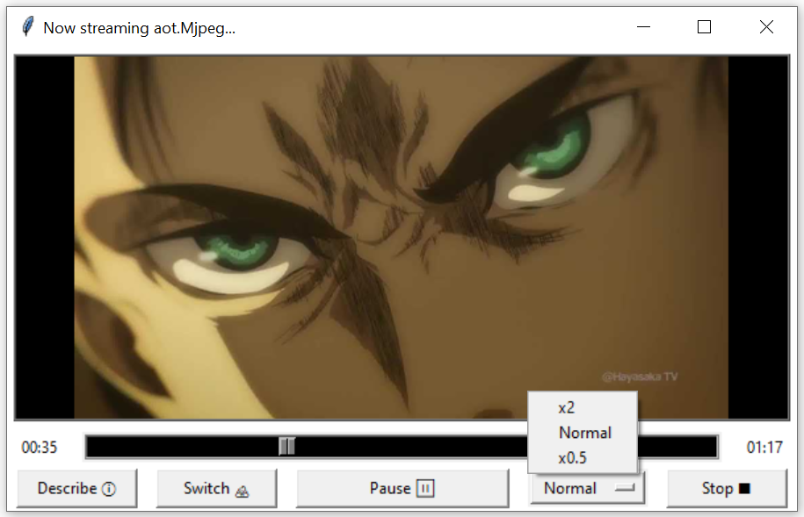
Changing playback speed

Slide 18
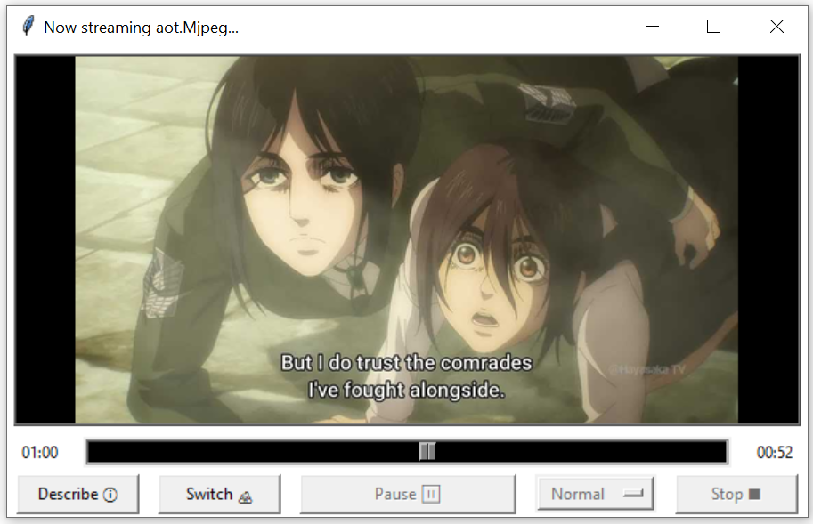
the video is stopped

Slide 19
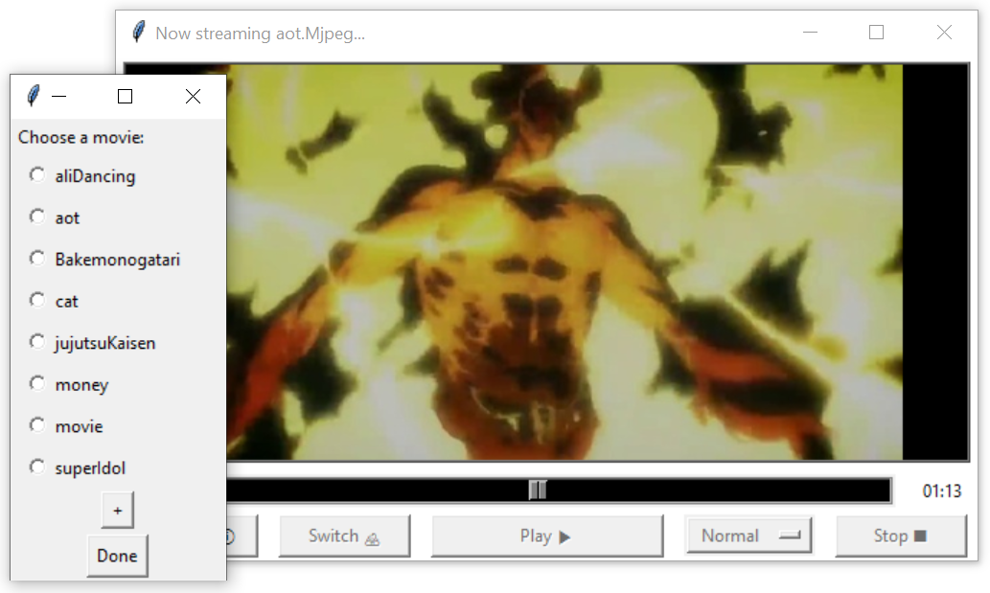
Switching videos
Notes:
Server os.listdir()

Slide 20
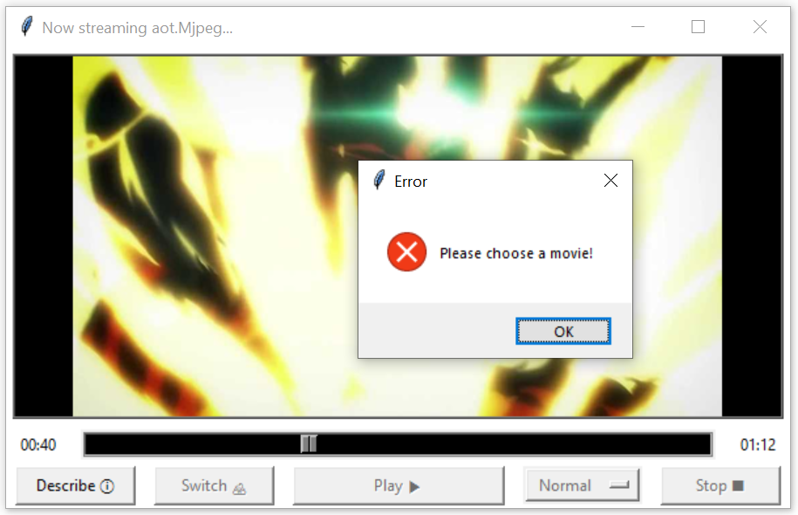
Error for not choosing movies

Slide 21
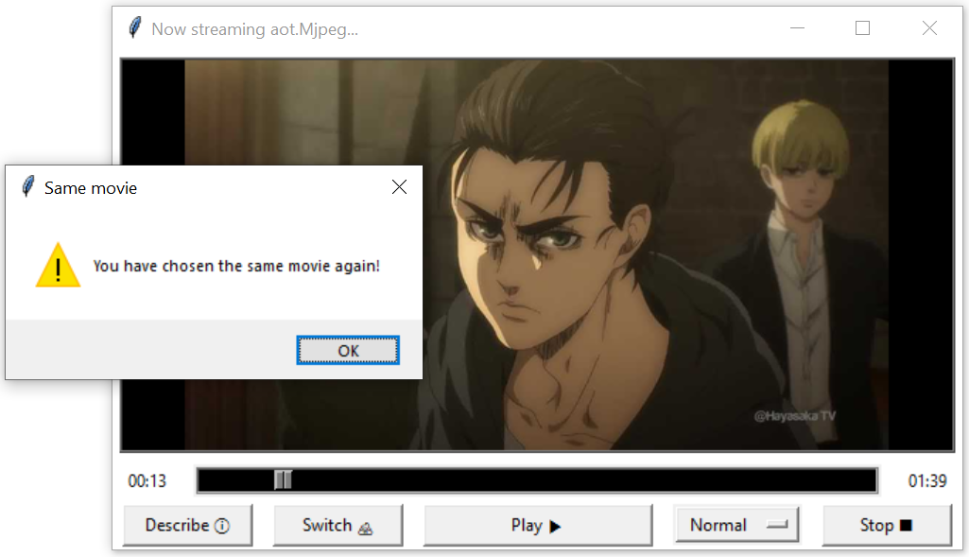
Warning for choosing the same movie

Slide 22
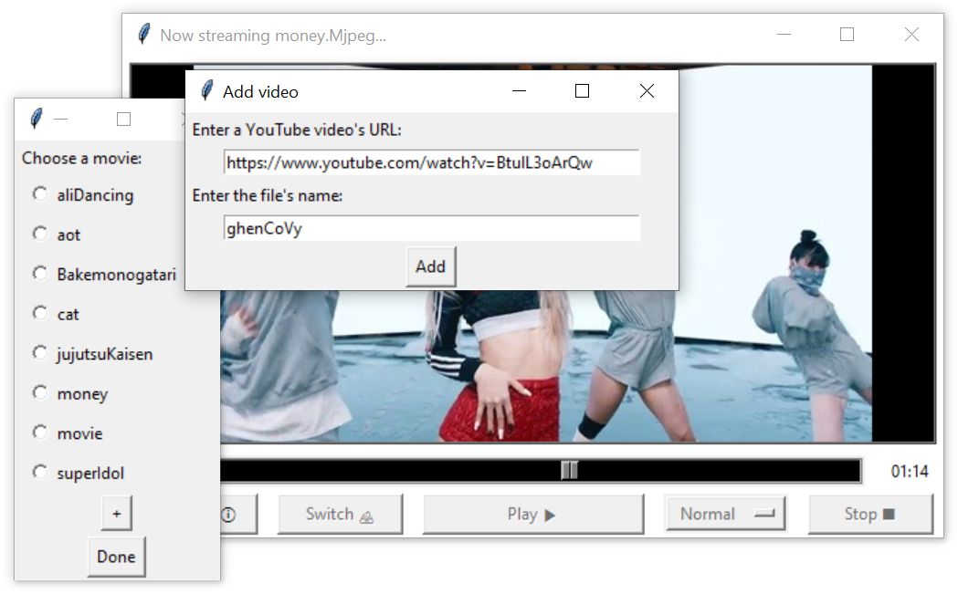
Adding Movies

Slide 23
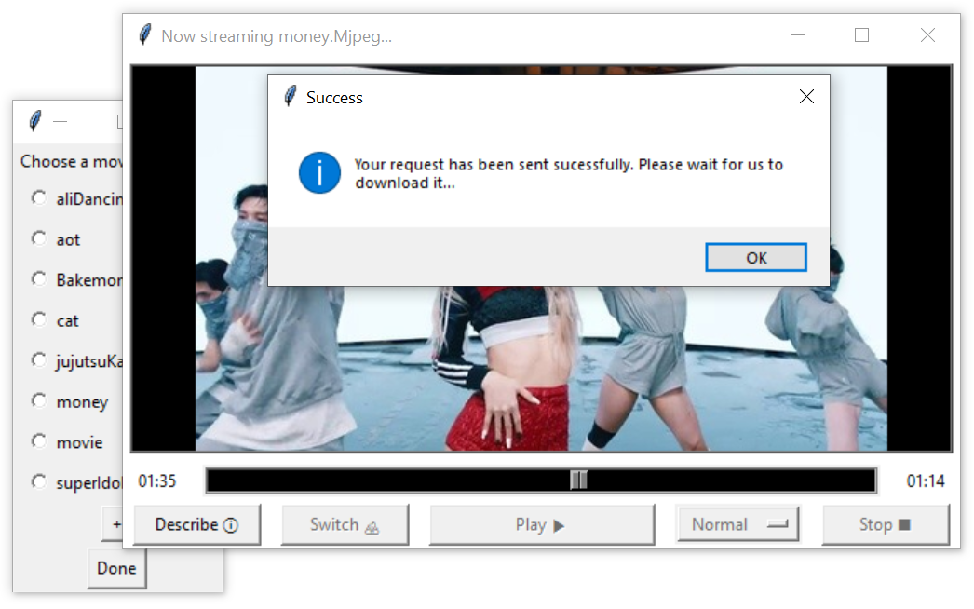
Adding Movies

Slide 24
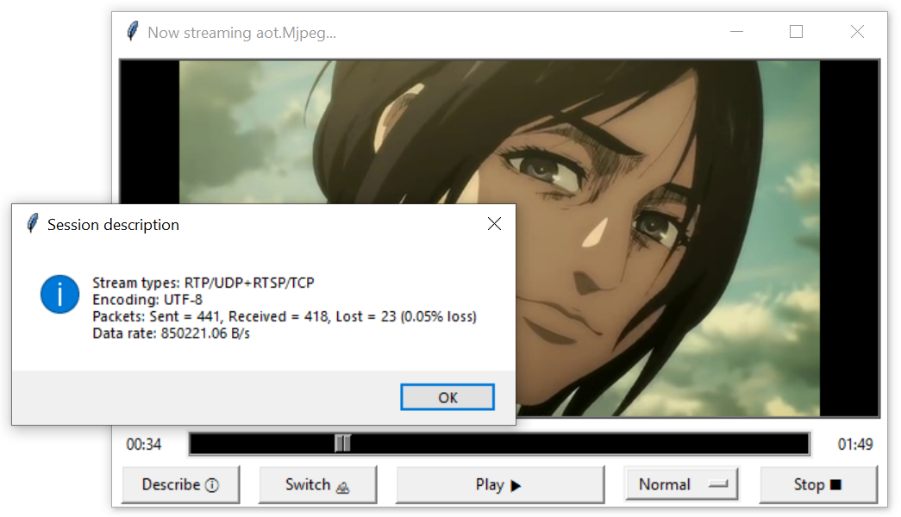
The stream’s metadata
Notes:
Cách tính mấy con số packet lost

Slide 25
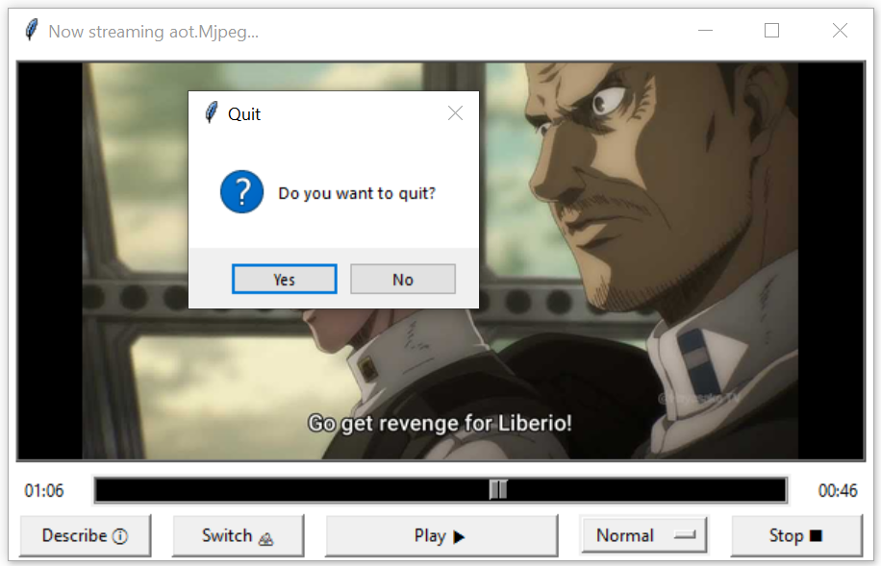
Closing the client

Slide 26
05
Evaluation

Slide 27
Overview
High frame rate: ≤ 40fps
Low packet lost: 0%
High data rate: ≤ 800000Bps
Low resource usage
Notes:
Low packet lost: 0% in our most recent test

Slide 28
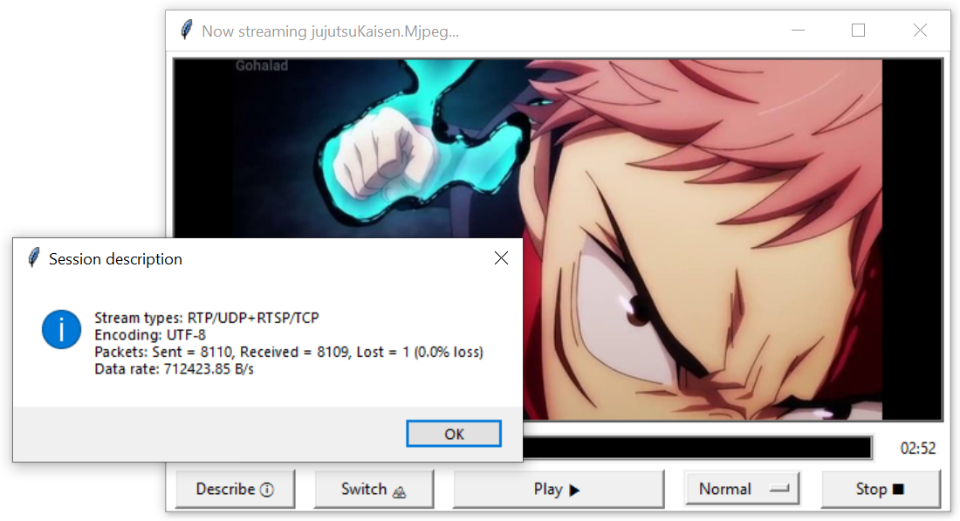
PACKET LOST & DATA RATE

Slide 29
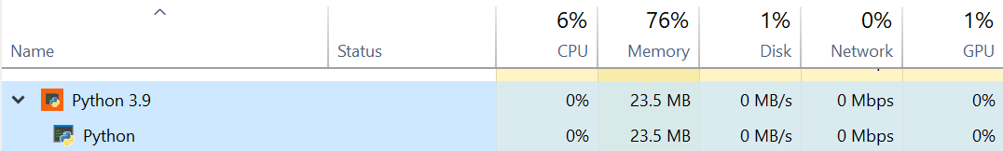
Resource usage
No clients are connected
Server: listens for new clients

Slide 30
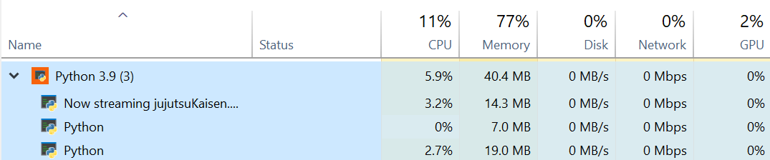
Resource usage
Two clients are connected
Server: listens for new clients + sends frames
Client 1: receives & processes frames
Client 2: receives & processes frames
Notes:
Process frames: resize + render them on the application

Slide 31
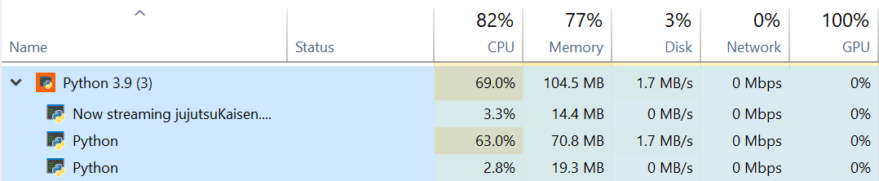
Resource usage
Server is downloading videos
Server: listens for new clients + sends frames + downloads & processes videos
Client 1: receives & processes frames
Client 2: receives & processes frames
Notes:
Server processes video: download => split frames using cv2 => resize => concatenate to frames to make Mjpeg

Slide 32
Demonstration
06
Local test
Remote test (VM)
Remote test

Slide 33
Technical Details: Problems & solutions
07

Slide 34
7.1
Problems in the sample code

Slide 35
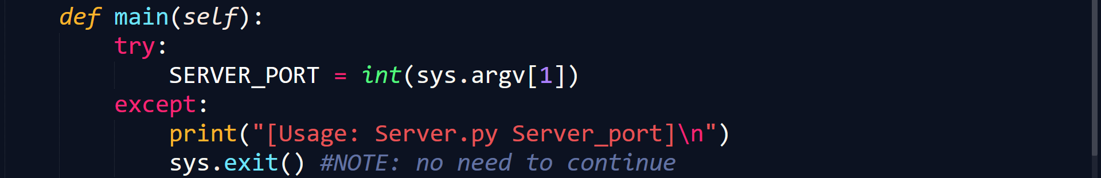
Problems in the sample code
In Server.py

Slide 36
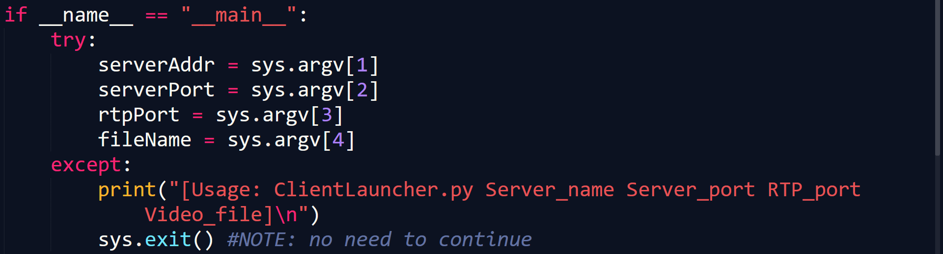
Problems in the sample code
In ClientLauncher.py

Slide 37

Problems in the sample code
In ServerWorker.py: processRtspRequest() – SETUP request

Slide 38
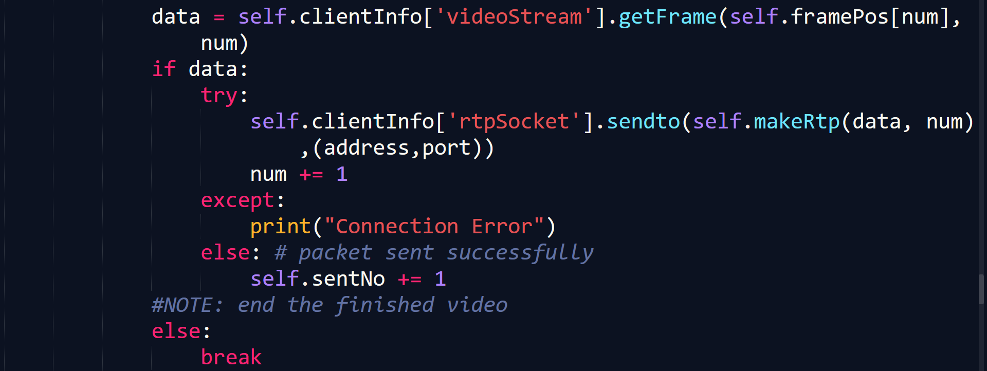
Problems in the sample code
In ServerWorker.py: sendRtp()

Slide 39
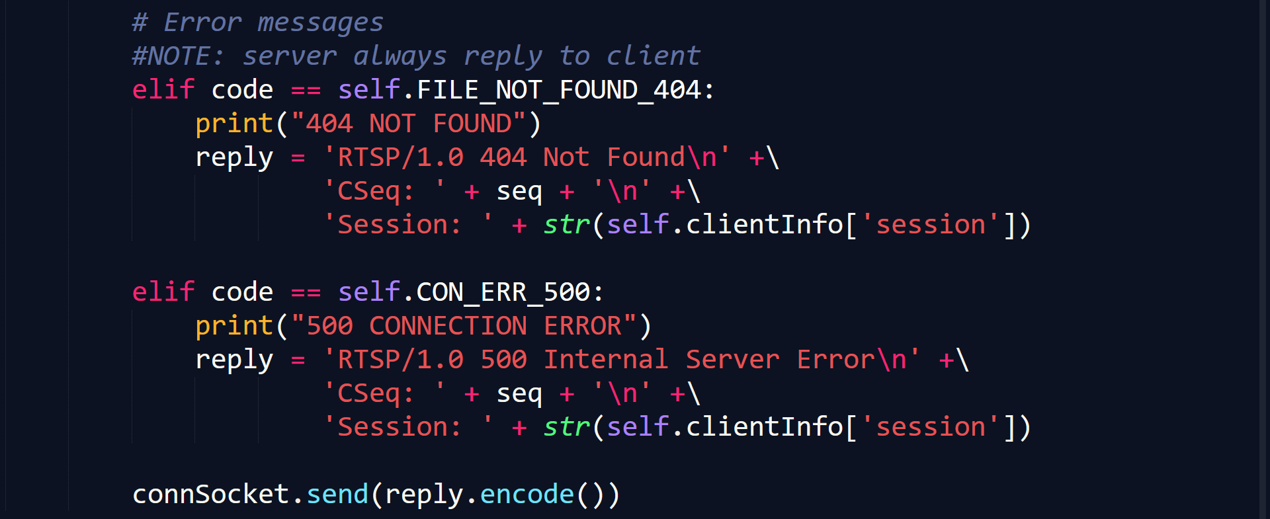
Problems in the sample code
In ServerWorker.py: replyRtsp()

Slide 40
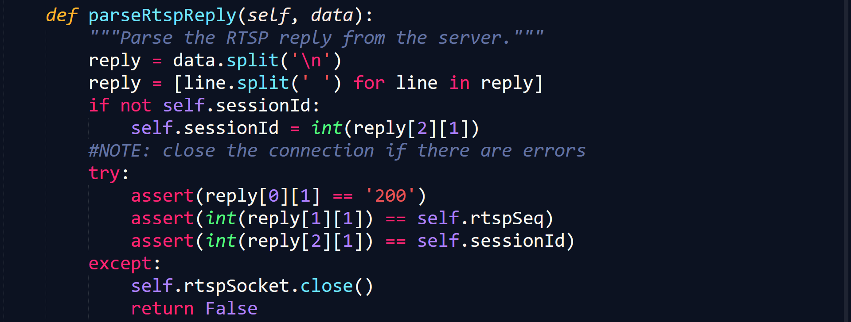
Problems in the sample code
In Client.py

Slide 41
7.2
SUGGESTIONs FOR a better specification

Slide 42
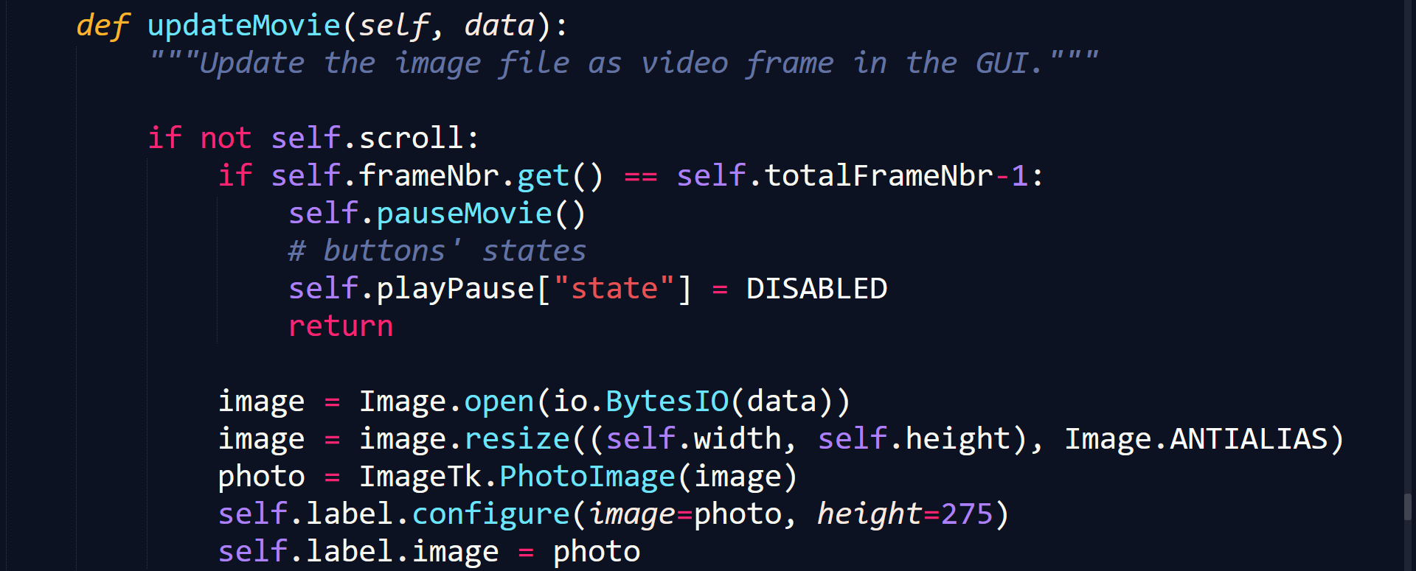
The cache images
In Client.py

Slide 43
The Frame rate
Assuming constant queuing delay in the OS’s and routers and total processing time < 0.05s (proven empirically)
20fps => 1 frame each 0.05s
Server
wait
process
Client
0.05s
wait
process
delay
Notes:
0.05s delay in original code
Gray: dead time

Slide 44
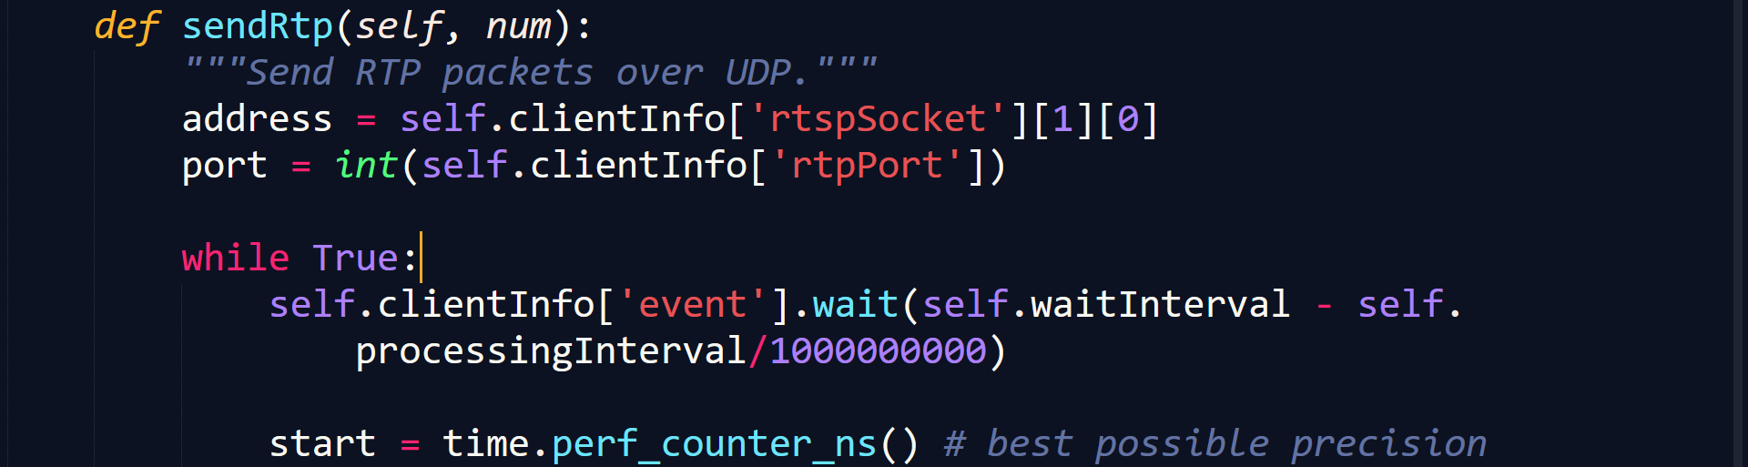
Dynamic processing interval
In ServerWorker.py
#<< Processes and sends frames >>
Notes:
exponentially decaying average of sending interval's length to dynamically adapt the sending rate for better timing

Slide 45
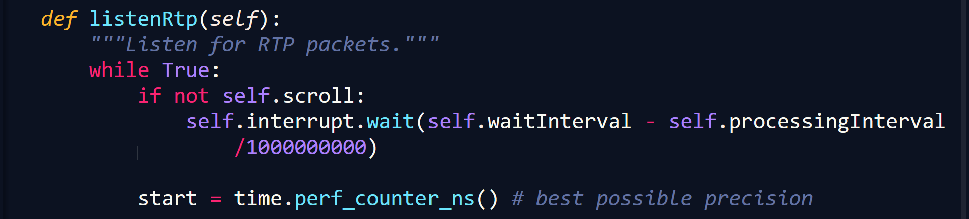
Dynamic processing interval
In Client.py
#<< Processes and renders frames >>
Notes:
In real test: still slower than real time (because of the unforeseeable queuing delay)

Slide 46
7.3
Additional features

Slide 47
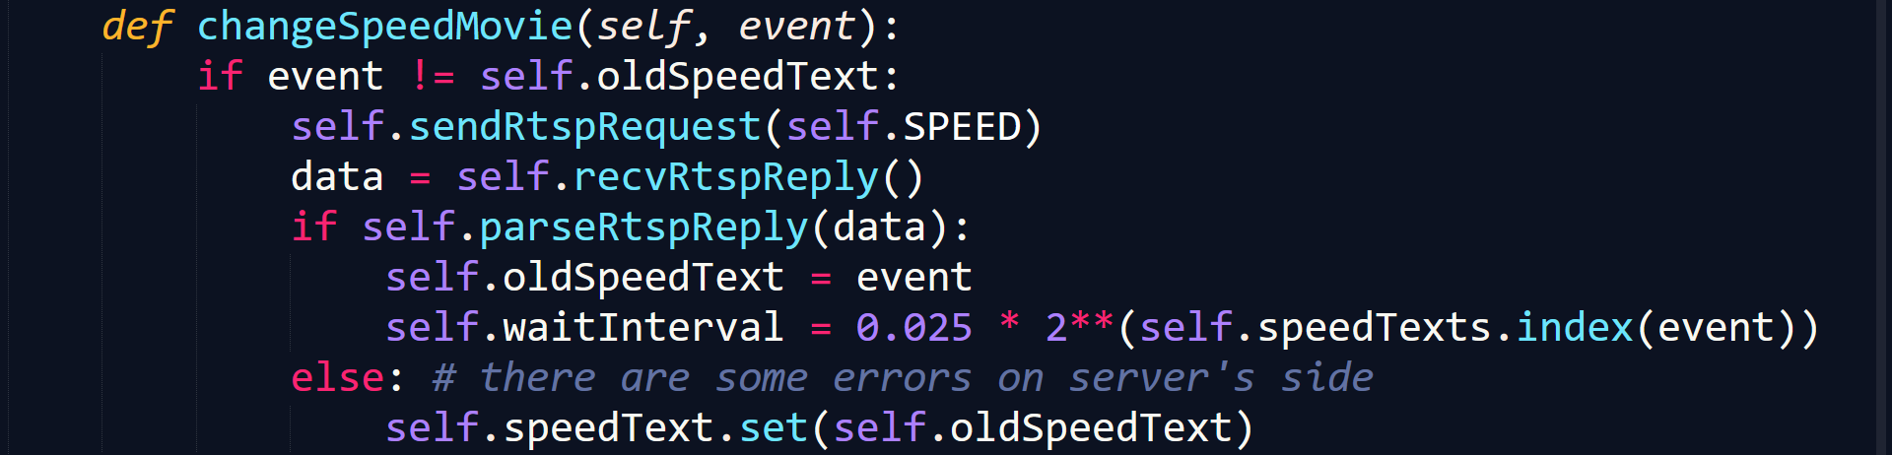
The change speed feature
In Client.py

Slide 48
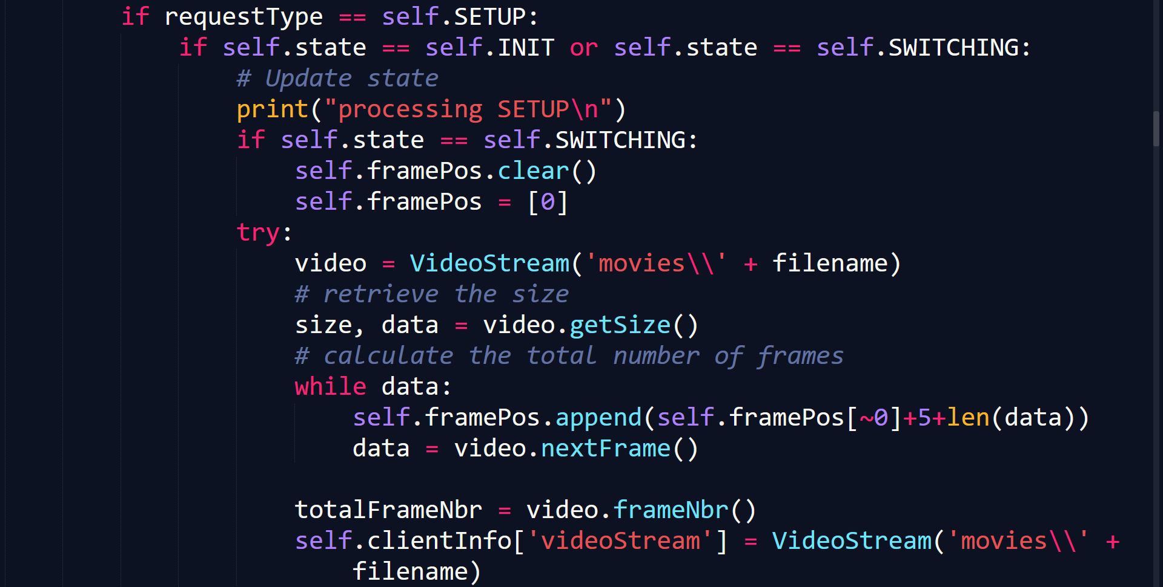
The SCROLLBAR feature
In ServerWorker.py

Slide 49
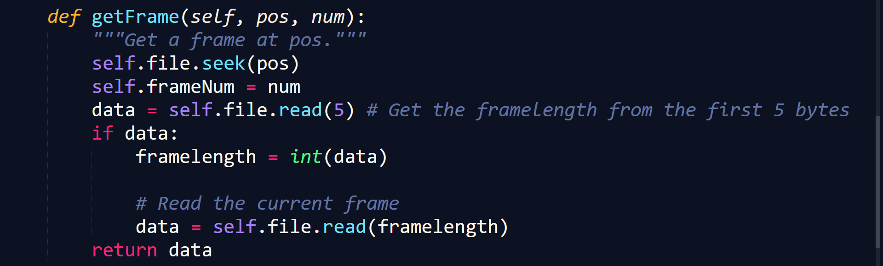
The SCROLLBAR feature
In VideoStream.py

Slide 50
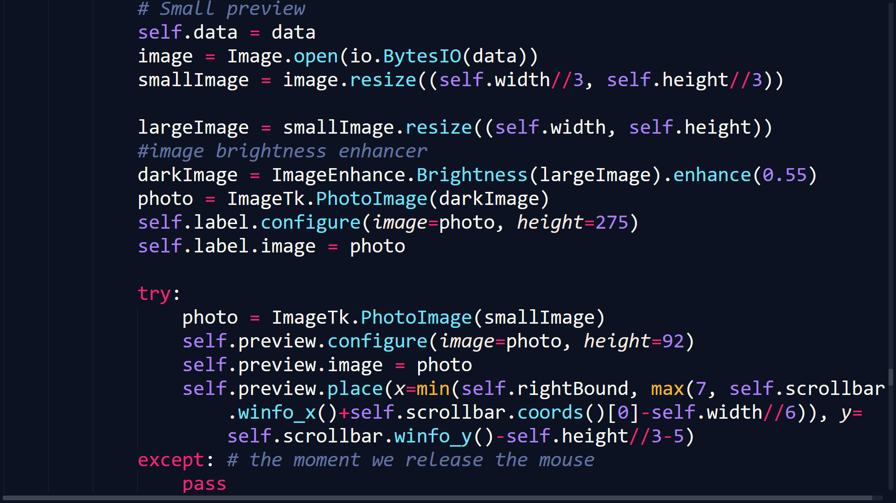
The mini-preview when scrolling
In Client.py: updateMovie()

Slide 51
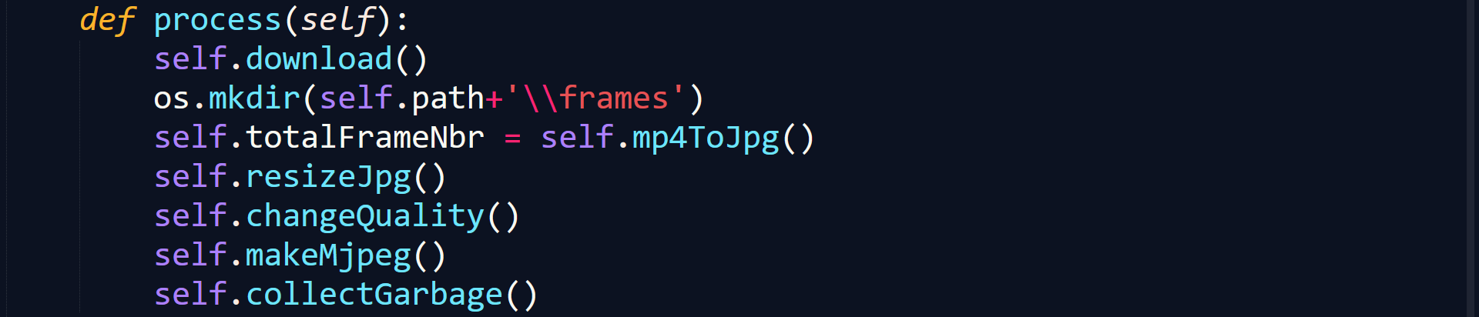
The add video feature
In Youtube2Mjpeg.py

Slide 52
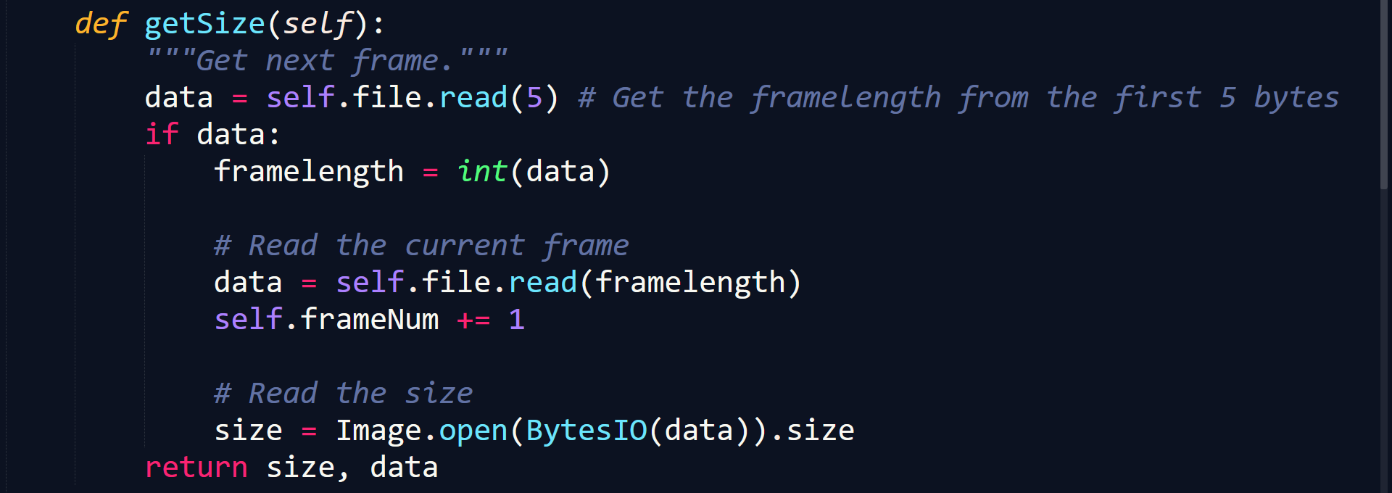
Different frame sizes
In VideoStream.py

Slide 53
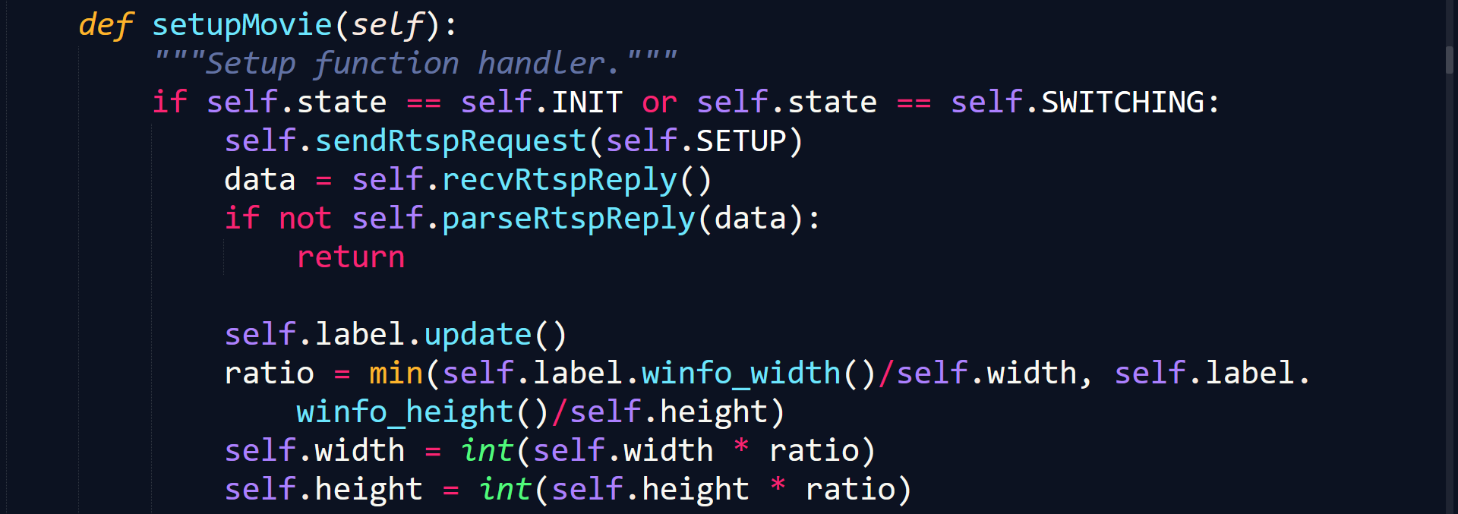
Different frame sizes
In Client.py

Slide 54
7.4
Resource deallocation

Slide 55
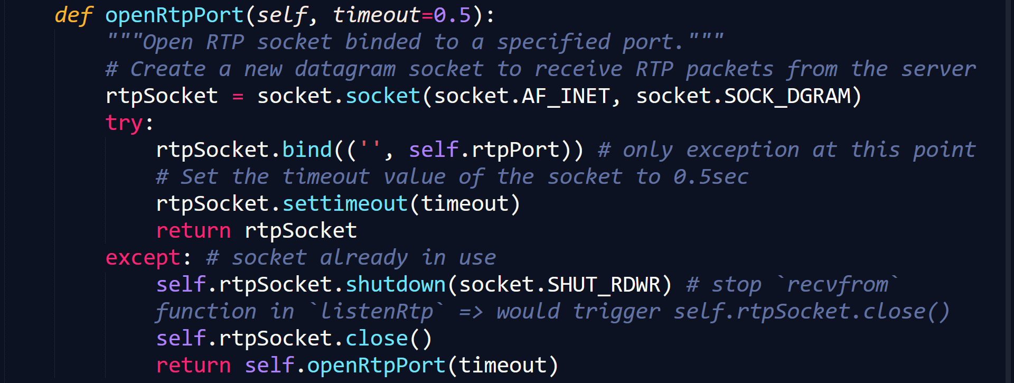
The UNUSED RTP SOCKETS
In Client.py
Notes:
Recursive:
- There is exception => rtpSocket is being used => get to the `except` claused + rtpSocket timeouts at that time also =>

Slide 56
The unused file handler
In VideoStream.py

Slide 57
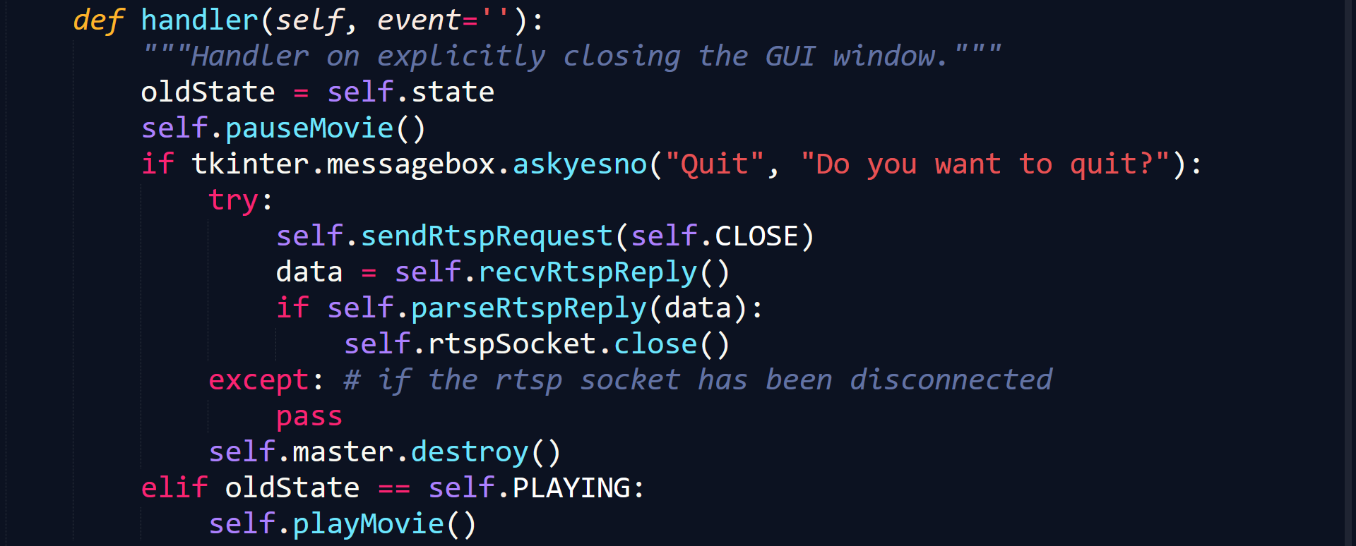
The close request
In Client.py

Slide 58
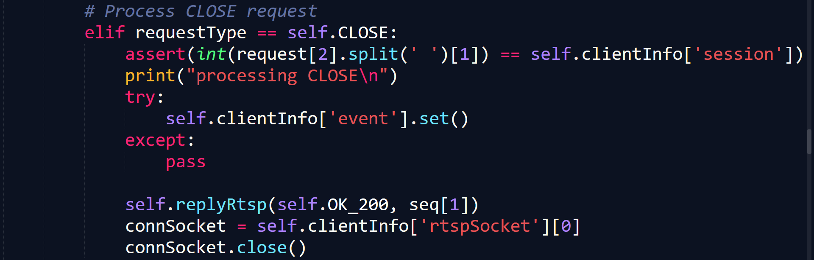
The close request
In ServerWorker.py

Slide 59
7.5
Miscellaneous

Slide 60
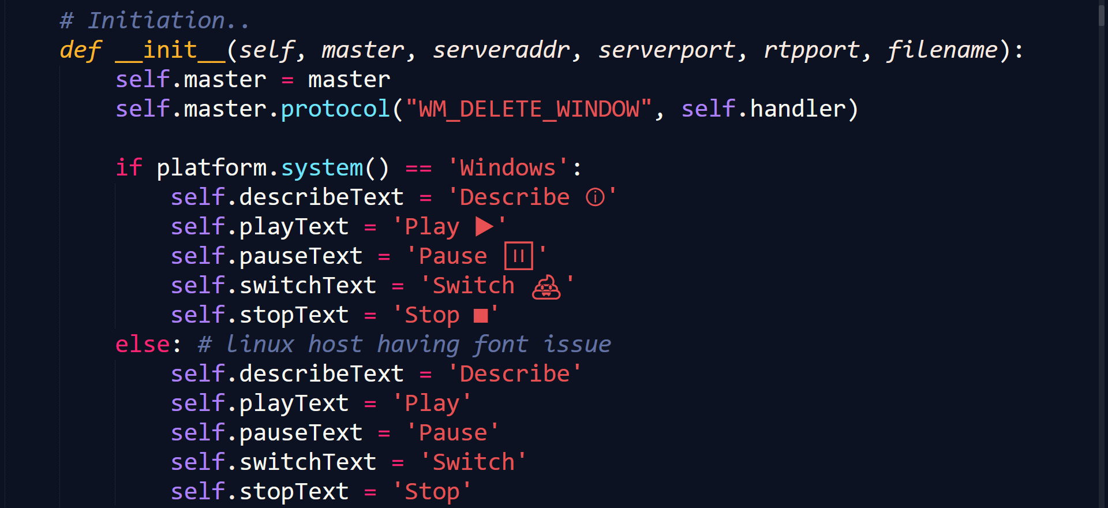
The font issue in Linux
In Client.py

Slide 61
The UDP datagram’s max size
In Client.py: listenRtp()

Slide 62
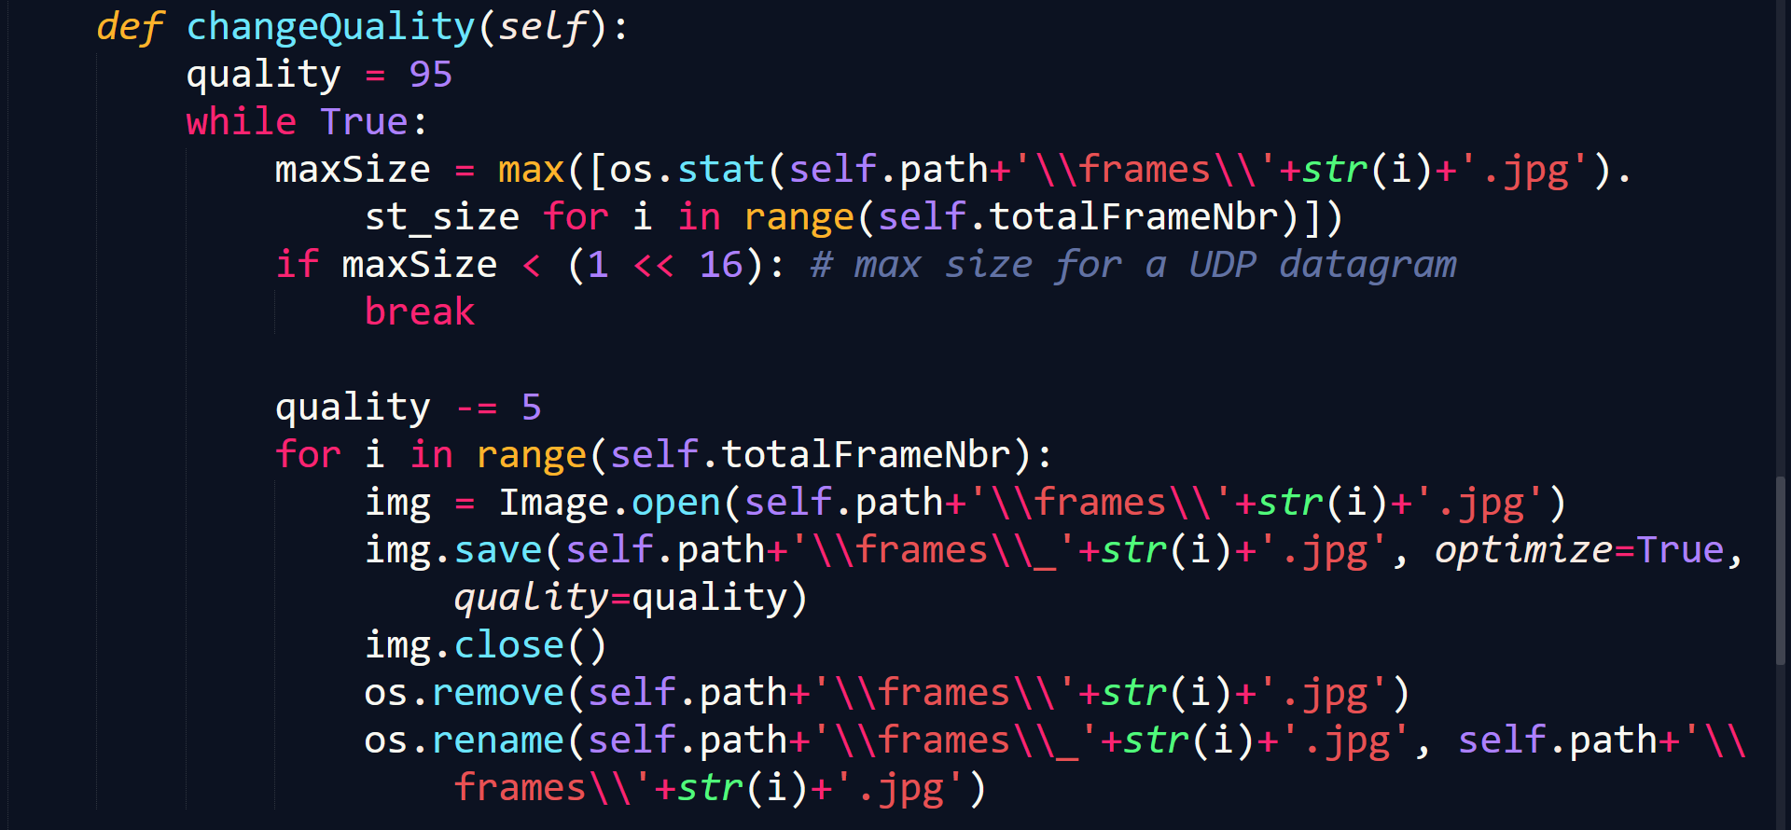
The UDP datagram’s max size
In Youtube2Mjpeg.py

Slide 63
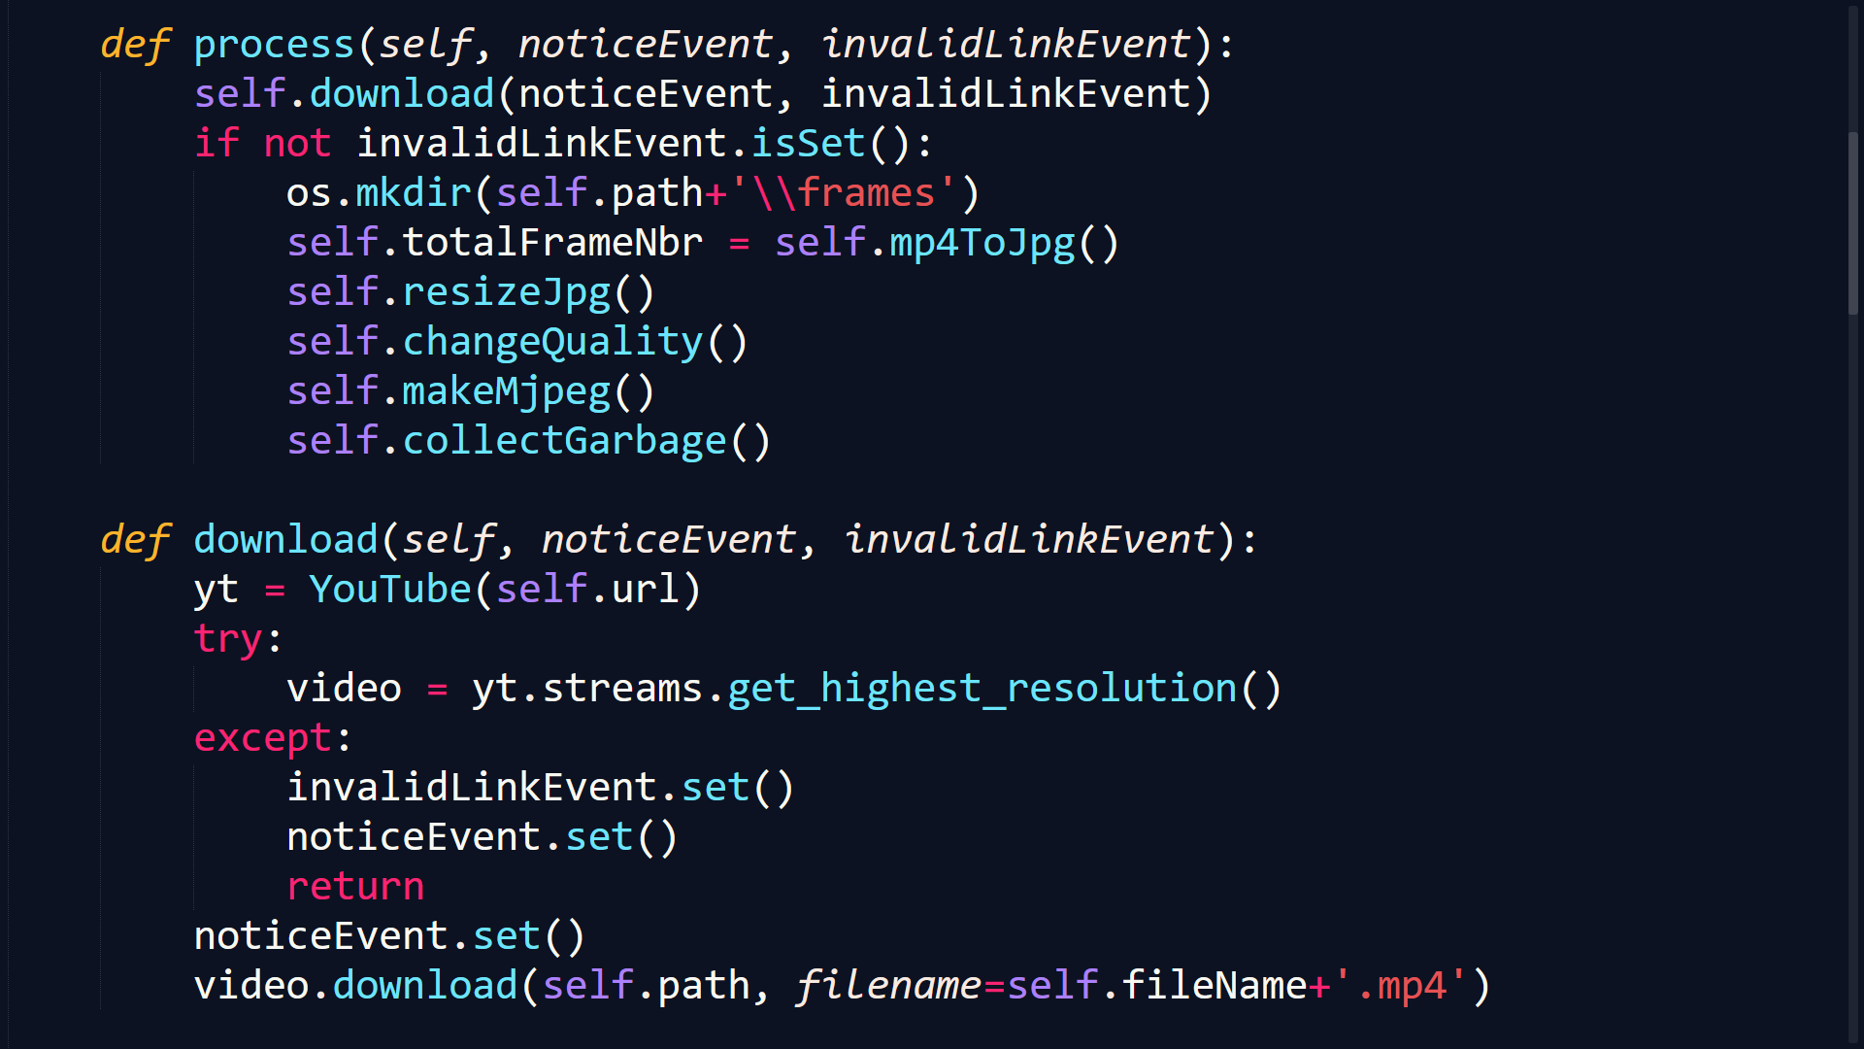
Invalid YouTube link
In Youtube2Mjpeg.py

Slide 64
08
Possible Improvements

Slide 65

BUFFER on the client’s side
Notes:
Using a queue of frames in RAM of the client and send at maximum capacity at server’s side
Ruin the goal of the assignment: real-time streaming => didn’t implement it

Slide 66


Audio streaming
Notes:
Too much now :v

Slide 67
Conclusion
09
Notes:
Lessons: make sure that the state on Client and ServerWorker are the same at anytime, etc.
Ad-hoc implementations, etc.

Slide 68
Research resources
Tkinter 8.5 reference: a GUI for Python (anzeljg.github.io)
Python - GUI Programming (Tkinter) (tutorialspoint.com)
Python Tkinter Tutorial - GeeksforGeeks

Slide 69
Thanks!
DO YOU HAVE ANY QUESTIONS?

